Slide 1


IEEE UV2026
General Information
Xiaoman Duan & Yajun Fang
IEEE UV2026 Organizing Committee
IEEE UV Conference Board
https://universalvillage.org/ieee-uv-conference

Slide 2


Slide 3
UV Concept & IEEE UV Conferences
Universal Village (UV) is a new concept proposed by MIT’s Universal Village Program in 2012. UV exemplifies an ideal future society that pursues harmony between humans and nature through the wise use of advanced technologies.
Led by the MIT professors who initiated the MIT UV program as well as the UV conferences, the IEEE UV Conferences call for collective efforts from world-renowned experts across multi-disciplinary fields to collaborate beyond traditional field boundaries. Previous IEEE UV conferences (UV2013, UV2014, UV2016, UV2018, UV2020, UV2022 and UV2024) were groundbreaking international venues that inspired successful collaboration among governments, academia, industries, and civil society.
https://universalvillage.org/ieee-uv-conference

Slide 4

The UV Concept
Universal Village (UV) & Future Lifestyles
Universal
Following the laws of the universe
Village
Cities are not the only living environments
Universal
Village
New lifestyles beyond Smart Cities following the laws of the universe
Notes:
我热烈欢迎所有参加首届国际Universal Village大会（UV2013）的与会者。我也要向我们的东道主清华大学以及在过去一年里对UV2013大会筹备给予支持的所有人表示诚挚的感谢。
正如大家所知，人类在现代技术方面取得了巨大的进步。今天，我们很常见到家用物品到基础设施被加上“智能”的字眼，这反映了人们对智能化的渴望。与此同时，大自然一直在忍受着人类社会进化留下的足迹。挑战在于如何实现人与自然的和谐，以便为所有社区成员实现可持续的幸福。
“Universal Village（UV）”的概念被提出作为解决这一挑战的可能方案。UV包括以下几个方面：多功能多格式的社区和一个新的生活方式，融合了城市和郊区的理想混合。这一新概念是基于需求的，以人为本和以自然为本的。在这一新范式中，需要一种系统的自上而下的设计方法。现代技术将被智慧地用来满足人类和自然的需求。调查未来发展的不同组成部分之间的整合和动态相互作用，以及子组件对整个系统的动态影响至关重要。在此过程中，将开发关键的智能技术，这些技术可能会为未来的城市化和UV的发展带来真正的智能。
此次大会汇集了不同领域的专家。通过大会，通过专家之间的互动，可能会诞生UV的新想法。我希望每个人都能享受UV2013，并在中国北京度过美好时光。

Slide 5
UV Elements
Science
Humanity
Technology
Design
UV
8 UV Sub-Systems
Smart Home and Community
Smart Medicine and Healthcare
ITS, Urban Planning and Crowd Management
Smart Energy Management
Smart City Infrastructure
Smart Response System for City Emergencies
Smart Environmental Protection
Smart Humanity
4 Impacting Factors
UV Information Flow
UV Material Cycles
UV Lifestyles
UV Communities

Slide 6
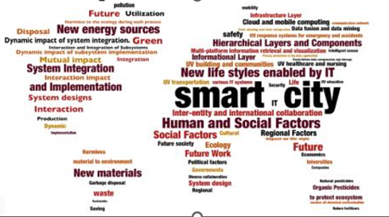
UV Scope

Slide 7

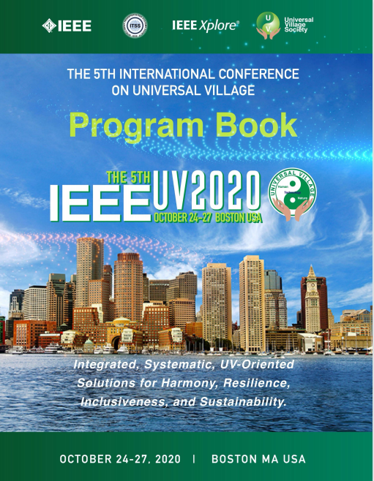




Previous UV Conferences (UV2013-UV2022)
UV2022
Virtual
POST-PANDEMIC REFLECTION ON HEALTH, HARMONY, AND SUSTAINABILITY: MOBILITY & VIRTUAL CONNECTION; DIVERSITY & SYSTEM EFFICIENCY; RESPONSIVENESS & RESILIENCE; INCLUSIVENESS & INTEGRATION
UV2020
Boston
INTEGRATED, SYSTEMATIC, UV-ORIENTED, SOLUTIONS FOR HARMONY, RESILIENCE, INCLUSIVENESS AND SUSTAINABILITY
UV2018
Boston
DIVERSITY, MOBILITY AND CONNECTIVITY FOR EMERGENCE OF HARMONY IN UNIVERSAL VILLAGE
UV2016
Nagoya
UV FOR REGIONS AT DIFFERENT DEVELOPMENT PHASES, PEOPLE AT DIFFERENT AGES WITH VARIOUS TECHNOLOGY & CULTURAL BACKGROUNDS
UV2014
Boston
INNOVATE FUTURE LIFESTYLE FOR SUSTAINABLE HAPPINESS
UV2013
Beijing
HUMANKIND IN HARMONY WITH NATURE THROUGH WISE USE OF TECHNOLOGY

Slide 8
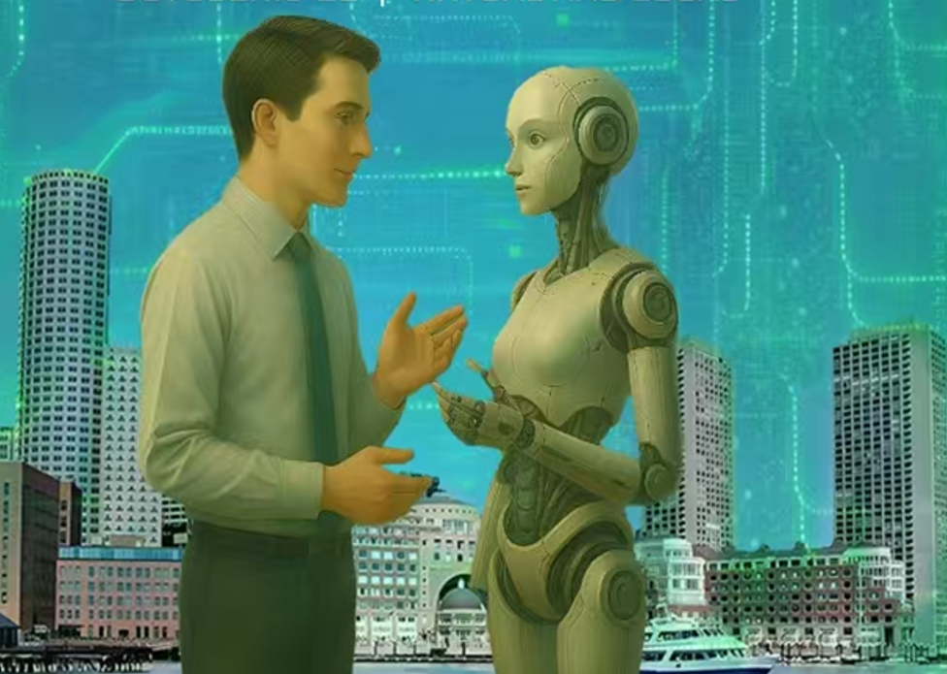


Previous UV Conferences (UV2024)
Reflection of Human - AI Relationship and AI-Pervasive Society Transformation:
Human-centricity, Explainable AI, and Intent & Behavior Understanding for Integration, Resilience, Inclusiveness, and Sustainability

Slide 9

Human-Centered AI Transformation for Future Empowerment:
IEEE UV2026 Themes
Explainable & Human-Intelligible Understanding
Intent-Aware Reasoning & Accountable Decision-Making
Human-Authorized AI Action
Human-Supervised Reflective Learning

Slide 10
Introduction to IEEE UV2026
After the great success of IEEE UV2024 and IEEE UV2022, the 8th International Conference on Universal Village (IEEE UV2026) will be held both Virtually and Locally from October 17-20, 2026.
Subjects for IEEE UV2026 include but are not limited to the following topics:
The Human - AI Relationship and AI-Pervasive Societal Transformation
Developing systematic methodologies to advance UV technologies and to develop UV systems, including Intelligent Transportation Systems, Urban Planning and Crowd Management, Smart Infrastructure, Smart Response Systems for Emergencies, Smart Energy Management, Smart Environmental Protection, Smart Home and Community, Smart Medicine and Healthcare, and Smart Humanity
New lifestyles enabled by IT / New energy sources / New materials / Effective microorganism technology and environmental protection
Exploring UV development paths that are appropriate for different regions at different development phases, from theoretical exploration, research development, framework design, implementation, engineering, to integration.
Inspiring successful collaboration among governments, academia, industries, and civil society to address different UV challenges and seek practical UV solutions

Slide 11
UV2026 Program Committees (TBD)
Program Chairs
Shengsheng Cao (Ningbo Univ., China)
Zili Li (MIT, USA)
Hao Sheng (Beihang Univ., China)
Hiro Aoki (Nagoya Univ., Japan)
Wenya Du (UVS, USA)
Yi Tao (UVS, USA)
Juntao Jiang (Zhejiang Univ., China)
Zhenyao Liu (UPenn, USA)
Publication Chairs
HaoYuan (Stephen Inst. of Tech., USA)
Hongyan Cui (MIT&BUPT, USA)
Lifeng Zhang (BJMU, China)
IT Chairs
Jieren Kou (NYU, USA)
Hanxia Li (UVS, USA)
Zhenqian Huang (Hohai Univ., China)
Chuqiao Gu (Google, USA)

Slide 12
UV2026 Executive Committees (TBD)
Honorary Chair
Berthold K.P. Horn (MIT, USA)
General Chairs
Roy E. Welsch ((MIT, USA)
Kazuya Takeda (Nagoya Univ., Japan)
Ahmad Hussein (IAV GmbH , Germany)
Ozaki Nobuyuki (Nagoya Univ., Japan)
Ji Li (Tsinghua Univ., China)
Lionel C. Kimerling (MIT, USA)
Shuguang Zhang (MIT, USA)
Technology Chairs
Yajun Fang (UVS, USA)
Xiaoman Duan (UVS, USA)
Yasha Yi (UWM, USA)
Conference Chairs
Lin Zhang (Beihang Univ., China)
Clinton J. Andrews (Rutgers Univ., USA)
Juejun Hu (MIT, USA)
Francisco B. Barnes (Tenure&Ecology LLC, Spain)
Executive Conference Chairs
Lin Zhang (Univ. at Buffalo, USA)
Longfei Zhou (UNF, USA)
Viksit Kumar (Novateur, USA)
Local Chair
Wei Wang (UVS, USA)

Slide 13
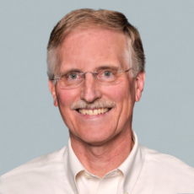
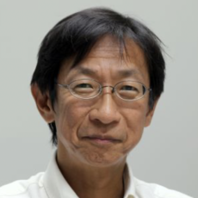
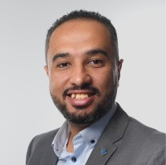
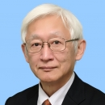
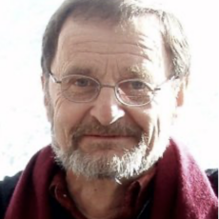
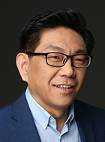
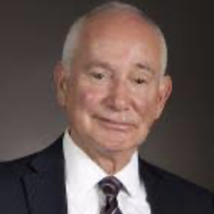
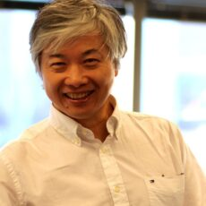
IEEE UV2026 General Committee
Honorary Chair
Roy E. Welsch (MIT, USA)
Kazuya Takeda (Nagoya Univ., Japan)
Ahmed Hussein (IEEE ITSS，USA)
Ozaki Nobuyuki
(Nagoya Univ., Japan)
General
Chairs
Berthold K.P. Horn (MIT, USA)
Ji Li (Tsingda, China)
Lionel C. Kimerling (MIT, USA)
Shuguang Zhang
(MIT, USA)

Slide 14
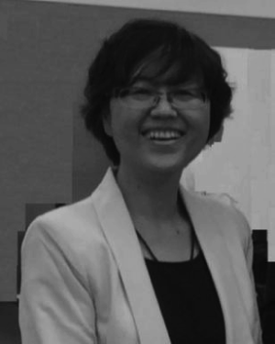
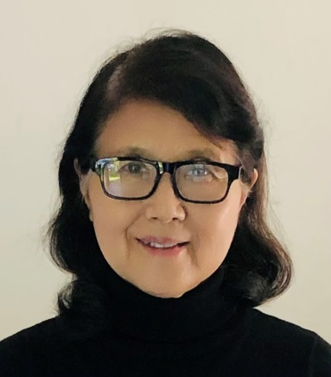
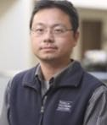
IEEE UV2026 International Committee
International Chairs
Yajun Fang (UVS, USA)
Xiaoman Duan (UVS, USA)
Yahsa Yi
(UMich, USA)

Slide 15
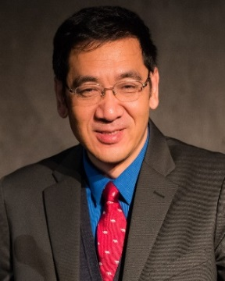
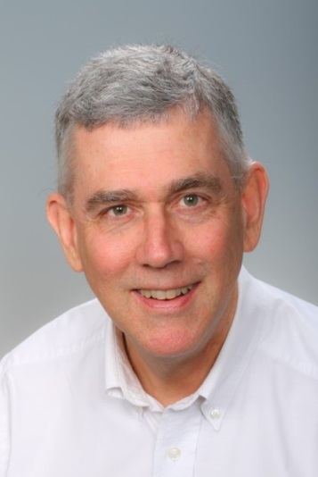
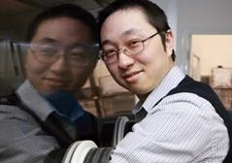
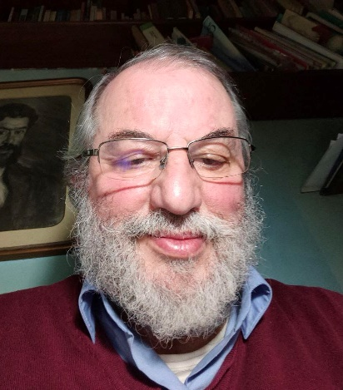
IEEE UV2026 Conference Committee
Conference Chairs
Lin Zhang (Beihang Univ., China)
Clinton Andrews
(Rutgers Univ., USA)
Juejun Hu (MIT, USA)
Francisco Bozzano Barnes (Tenure&Ecology LLC, Spain)

Slide 16
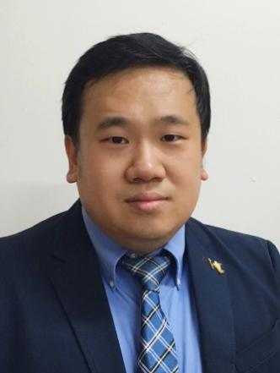
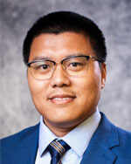
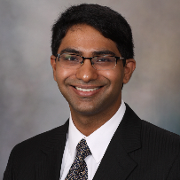
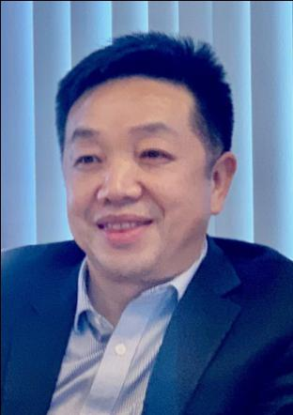
IEEE UV2026 Executive Committee
Executive Conference Chairs
Local Chairs
Lin Zhang (MIT, USA)
Longfei Zhou (Gannon Univ., USA)
Viksit Kumar
(Novateur, USA)
Wei Wang
(Robostreet, USA)

Slide 17
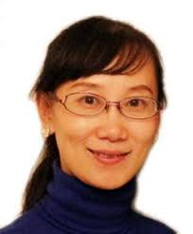
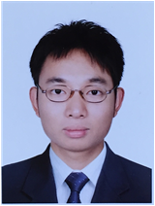
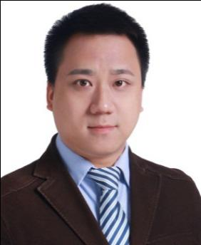
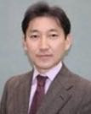
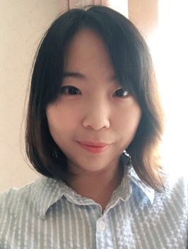
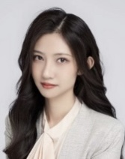
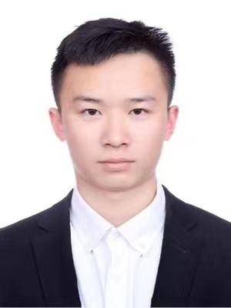
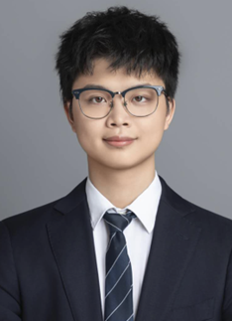
IEEE UV2026 Program Committee
Program
Chairs
Shengsheng Cao (Ningbo Univ., China)
Zili Li
(MIT, USA)
Hao Sheng
(Beihang Univ., China)
Hirofumi Aoki
(Nagoya Univ., Japan)
Wenya Du
(MIT, USA)
Yi Tao
(UVS, USA)
Juntao Jiang
(UVS, USA)
Zhenyao Liu
(UPENN., USA)

Slide 18

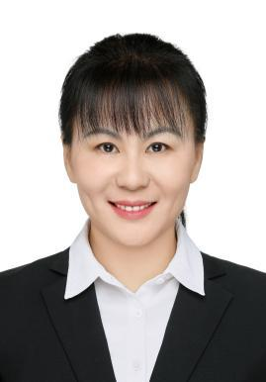
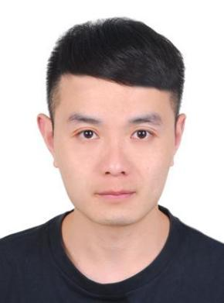
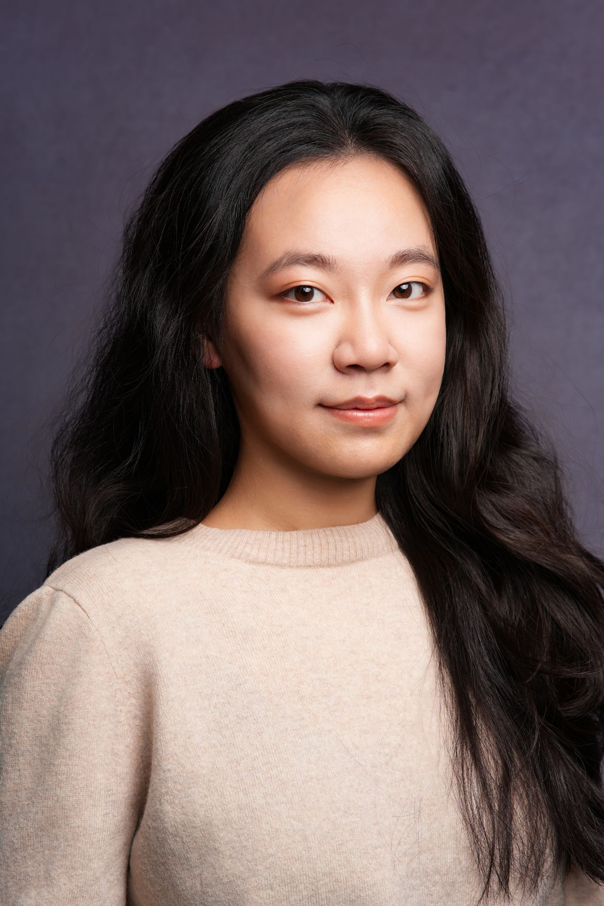
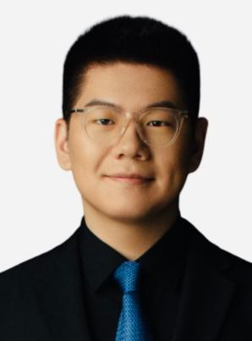

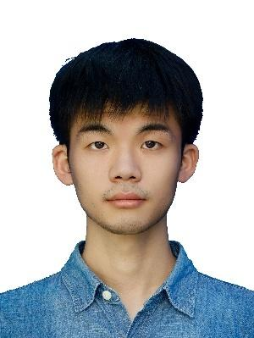
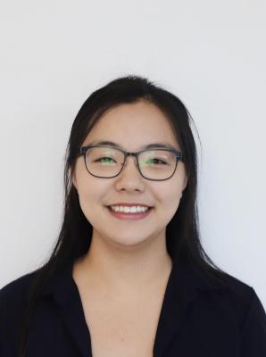
IEEE UV2026 Program Committee
Publication
Chairs
Hao Yuan
(Stevens Inst. of
Tech., USA)
Hongyan Cui
(MIT/BUPT, USA/China)
Lifeng Zhang
(UVS, USA)
Ge Cheng
(UVS, USA)
IT
Chairs
Jieren Kou (UVS, USA)
Hanxia Li
(UVS, USA)
Zhenqian Huang
(UVS, USA)
Chuqiao Gu
(Google, USA)

Slide 19
IEEE UV2026 Program Committee
Administrative Chairs
Jason Chang (UVS, USA)
Ryan VanBusum (UVS, USA)
Yilin Wang (UVS, USA)
Education Chairs
Fan Chen (Harvard Univ., USA)
Jenny Wan (Sage Hill Consulting, USA)
Bali Nelson (Nelson ESL Consulting, USA)
Public Relation Chairs
Yohji Suhara (Community Technology Institute, Japan)
Javier Sanchez Medina (EU/ULPGC, Spain)
Toshimitsu Hamada (Tsukuba Gakuin Univ., Japan)
Junyi Yu (Columbia Univ., USA)
Mingyuan Hu (UVS-Nanjing, China)
Weimin Hong (UVS, USA)
Yulan Yang (SQIAST, China)
City Forum Chairs
Huibo Liu (Fortune Talent LLC, China)
Heng Ding (Joy Wisdom, China)
Qinghe Kong (Jiyuan, China)
Media Chairs
Yanyan Li (Sichuan Univ., China)
Ronghua Chen (Oriental Foco Films, Singapore)
Lan Huo (UVS, USA)
Benjamin Cheung (Architectural Illusions, USA)
Financial Chairs
Zeyao Wang (Duke Univ., USA)
Sophia Wei (UVS, USA)
Panel Discussion Chairs
Gene Fry (Global Warming Consultant. USA)

Slide 20
IEEE UV2026 Dates and Venues
Dates: October 19 - 22 , 2026
Following the Successful IEEE UV2022,
IEEE UV2026 will be Held
Virtually & Locally
Email : uv.conf.committee@universal-village.org
Website ：https://www.UniversalVillage.org

Slide 21
UV Program
Pt. I
Pt. II
11
Keynote Day
UV Forums
UV Competitions
Technical Sessions
1. UV Data Science Competition
2. UV Modeling Competition
3. UV Pitch Competition
4. UV K-12 Challenge
1. UV City Forum
2. UV Student Forum
3. UV Art Forum
Special Sessions
UV Workshop
UV Poster & Exhibition
Pt. III
UV Roadmap Discussion

Slide 22
IEEE UV2026 Basic Structure of Sessions
Keynote Day
Organized by IEEE UV2026 program committee
Opening remarks and invited keynote talks
Technical Sessions
Organized by session chairs
Distribute “Session Call-for-Papers” by session chairs
Session chairs select oral talks and review submitted papers
Special Sessions
Distribute “Call-for-Session-Proposals” by the program committee
Special sessions organized by special session chairs
Special session chairs select oral talks, panels, and organize paper submissions

Slide 23
Technical Sessions (A)
[Session 1] UV Vision, Development, and Evaluation
[TS1-A] Vision for Universal Village
[TS1-B] Development Status of Universal Village
[TS1-C] UV Indices, UV Incentive Mechanisms, and Evaluation of UV Subsystems - Methods, Technologies, and Systems
[Session 2] UV Framework Design, Modeling, and System Integration
[TS2-A] Systematic and Integrated Frameworks for UV Subsystems and Contributing Factors
[TS2-B] Intelligent Modeling, Simulation, and System Analysis
[TS2-C] Scalability, Sustainability, and Human-Centered Design in UV System Integration
[Special Session ] [TS2-SP1] Intersection of Energy, Power Science and Smart Cities
[Session 3] Mobility, Planning, Management, and Infrastructure Innovations
[TS3-A] Intelligent Transportation, Urban Planning, and Smart City Infrastructure
[TS3-B] Intelligent Vehicles, Mobility Support for Vulnerable Groups
[TS3-C] Smart Response Systems for City Emergencies
[TS3-D] Information Flow, Communication, Networks, and Security
[TS3-E] UV Underground: Underground Infrastructure & Future Urbanization Needs
[Special Session] [TS3-SP1] Built Environment, Travel Behavior, and Data-Driven Mobility Planning
[Special Session] [TS3-SP2] Sustainable Built Environments: Algorithmic Modeling and Generative AI Applications

Slide 24
Technical Sessions (B)
4. [Session 4] Energy and Material Innovations for Efficiency, Safety, and Sustainability
[TS4-A] Renewable Energy and Smart Energy Management
[TS4-B] Smart Materials and Devices
[Special Session] [TS4-SP1] Semiconductor Chip Manufacturing in the AI Era: Enabling 3D Optoelectronics & Next-Generation Integration
5. [Session 5] Manufacturing Innovations for Efficiency, Safety, and Sustainability
[TS5] AI-Enabled Manufacturing
6. [Session 6] Agriculture Innovations for Efficiency, Safety, and Sustainability
[TS6] AI-Driven Smart Agriculture: Bridging Tech Innovation & Sustainable Growth for Rural Vitalization
7. [Session 7] Environmental Innovations for Harmony between Humans and Nature
[TS7-A] Smart Environmental Protection; Smart Ecological Systems
[TS7-B] Mobility-enabled Material Cycles; the Circular Economy; Trash and Scrap Collection, Processing, Reuse, and Recycling
8. [Session 8] Lifestyle Style Innovations for Happiness
[TS8-A] Smart Homes and Community, Virtual Living
[TS8-B] Mobility, Connectivity, and Innovative Lifestyles
[Special Session] [TS8-SP1] Integration of Sports Science and Medical Research: Interdisciplinary Innovation in Sports, Traditional Chinese Medicine, and Western Medicine

Slide 25
Technical Sessions (C)
9. [Session 9] Healthcare Innovations for Safety and Well-Being
[TS9-A] AI-assisted Healthcare Monitoring
[TS9-B] Smart Medicine and Smart Healthcare
[TS9-C] Public Health, Epidemic Prevention and Control
[TS9-D] The Fusion of Traditional Chinese Medicine and Modern Science
[TS9-E] AI-Driven Sports Training, Exercise, and Fitness
[Special Session] [TS9-SP1] AI-Powered IoMT Telehealth Innovation
10. [Session 10] Social and Cultural Revolution for Diversity, Inclusiveness, Fairness, and Preservation of Cultural Heritage
[TS10-A] Urbanization, Social Governance, and Smart Communities
[TS10-B] Smart Government and Social Services
[TS10-C] Integrated Solutions for Smart Humanity
[TS10-D] Smart Design and Design Ethics
[TS10-E] Cultural Heritage Preservation and Creative Industries
[TS10-F] Equitable AI for the Underrepresented and Vulnerable Groups
Notes:
Category IX. Human-Centered Social Innovations to promote diversity, inclusiveness, fairness, and the preservation of cultural heritage

Slide 26
Technical Sessions (D)
11. [Session 11] Algorithms, Benchmark Development, and Data Management
[TS11-A] Responsible and Ethical Data Management and Processing
[TS11-B] Learning Algorithm and Model Development, Analysis, and Interpretability
[TS11-C] Benchmark Development, Evaluation, and Long-Term Reproducibility
12. [Session 12] Special Sessions - New Proposed Sessions
[SP12-A] AI and Finance
[SP12-B] Reconstructing Human-Centered Family Education in the AI Era: Learning, Parenting, and Relational Development
[SP12-C] Shanwei Forum: Quality-Driven Development of New Energy Vehicles through Sustainable Smart Manufacturing

Slide 27
Roles & Responsibilities for UV2026 Session Chairs

Slide 28
Timetable for Session Chairs
Date | Responsibilities / Tasks
August 1 | Finalize speaker and panelist profiles, including bios, affiliations, profile photos, talk titles, and abstracts.
September 1 | Conclude the peer-review process for manuscripts submitted by the official August 1 deadline. Issue official acceptance notifications to authors.
September 5 | Submit proposed session agendas to the Program Chairs, including preferred scheduling, speaker order, presentation durations, and total session length.
September 15 | Conclude the review process for Program Chair-approved late submissions, if applicable. (Round 1) Review final program arrangements and update session agendas, speaker titles, and abstracts.
September 30 | Complete any remaining review updates for approved late submissions, if applicable. (Round 2) Review and update the official Conference Program Book materials.
October 7 | Finalize remaining session updates and submit session documentation to the Program Chairs. (Round 3) Compile and submit session proceedings materials, subject to Program Chairs’ confirmation.
October 10–11 | Conduct technical connectivity tests with session speakers and collect backup presentation videos.
October 17–20 | [Official IEEE UV2026] Execute the live session, manage Q&A, and ensure adherence to the published schedule.
November 1 | Collect post-event revised files and final archive materials from invited speakers and general authors, if required.
November 8 | Submit updated session documentation and folders to the Program Chairs. Provide any necessary technical clarifications for the final archive.
Notes:
August 1 Finalize comprehensive profiles for invited-speakers.
September 1 Conclude the peer-review process for all manuscripts submitted by the Aug. 31, 2026, deadline.
Issue official notifications of acceptance to authors. Distribute technical specifications and detailed instructions for the preparation of camera-ready manuscripts Issue formal registration reminders to all prospective attendees and authors.
September 5 Submit the proposed session agendas to the Program Chairs for review:
Preferred scheduling (date and time), speaker sequences, individual presentation durations, total session lengths
September 15 Conclude the peer-review process for late submissions (Round 1).
Review final program arrangements and update session agendas, speaker titles and abstracts
October 1 Conclude the peer-review process for late submissions (Round 2) . Review and update the official conference program book.
October 7 Compile and submit the session conference proceedings.
October 10-11 Conduct technical connectivity tests with speakers and collect backup video presentations.
November 1 Collect final camera-ready manuscripts from invited speakers and general authors
November 8 Submit updated session documentation and folders to the Program Chairs.

Slide 29
Timetable for Program Chairs
Date | Responsibilities / Tasks
August 1 | Review and approve the roster of invited speakers to ensure technical alignment with UV2026 themes.
September 1 | Distribute technical instructions for preparing camera-ready manuscripts. Issue formal registration reminders to all prospective attendees and authors.
September 5 | Collect and synthesize session program proposals from Session Chairs to begin building the master schedule.
September 15 | Consolidate session program updates and synthesize the master agenda. Finalize scheduling and time slots with all Session Chairs.
September 25 | Commence formal compilation of the official Conference Program Book.
October 1 | Update and digitally publish the Conference Program Book on the official website. Compile online meeting instructions and notify all presenters and attendees.
October 10 | Update the Conference Program Book on the official website. Compile preliminary Conference Proceedings and generate secure download access for registered participants.
October 10–11 | Conduct technical connectivity tests with keynote speakers and collect backup video presentations.
October 17–20 | [Official IEEE UV2026] Coordinate the official Sessions and Keynote Program of IEEE UV2026.
November 1 | Audit collected manuscripts for IEEE formatting and copyright compliance.
November 17 | Incorporate post-event updates into the definitive Program Book and Conference Proceedings. Submit the final proceedings package to IEEE for possible archival and inclusion in IEEE Xplore, subject to IEEE scope, formatting, copyright, and quality requirements.
Notes:
September 5 Collect formal session program proposals from all Session Chairs.
September 15 Synthesize the conference agenda and program arrangements; finalize confirmation with all Session Chairs
September 25 Commence compilation Conference Program Book.
October 1 Update and Digitally publish the Conference Program Book on the official website.
October 7 Compile the instruction for online meeting and notify all presenters and attendees.
October 10 Compile the preliminary Conference Proceedings and generate secure download access for registered participants.
October 10-11 Conduct technical connectivity tests with keynote speakers and collect backup video presentations.
October 17 Official commencement of IEEE UV2026.
November 10 Finalize the definitive versions of the Program Book and Conference Proceedings,
incorporate any post-event updates
November 17 Submit the final Program Book and Conference Proceedings to IEEE for archival and inclusion in digital libraries.

Slide 30
Roles & Responsibilities of Session Chairs 【1】Session Organization
Prepare and distribute the session-specific “Call for Papers” poster. *
Prepare and distribute the “Session Committee & Invited Speakers” poster. *
Invite authors, session committee members, speakers, and reviewers.
Collect and submit speaker bios, profile photos, talk titles, and abstracts to the Program Chairs.
Organize paper reviews through the online review system. *
Submit the proposed session program and agenda to the Program Chairs.
Ensure that authors follow IEEE paper formatting and copyright requirements for camera-ready papers. *
Remind speakers and authors to register early to receive the early-bird rate.
* [To be completed together with Session Assistants]
Notes:
The main responsibilities of a session chair include sending out session-specific “Call for papers”and promoting the session, inviting speakers and reviewers for the session, organizing and following up with paper submissions and reviewing process, preparing session program, guiding authors to follow IEEE paper formatting rules for camera-ready papers, collecting speakers' bios and pictures, running and hosting this session smoothly during UV2020.

Slide 31
Roles & Responsibilities of Session Chairs – 【2】 Hosting Preparation
Keep Program Chairs updated on session progress and any program changes.
Notify speakers about their assigned time slots and confirm their availability. *
Ensure stable connections for remote presenters and stable performance of on-site audio/video systems. *
Collect backup presentation videos. *
Prepare roundtable discussion topics. *
* [To be completed together with Session Assistants]
Notes:
The main responsibilities of a session chair include sending out session-specific “Call for papers”and promoting the session, inviting speakers and reviewers for the session, organizing and following up with paper submissions and reviewing process, preparing session program, guiding authors to follow IEEE paper formatting rules for camera-ready papers, collecting speakers' bios and pictures, running and hosting this session smoothly during UV2020.

Slide 32
Roles & Responsibilities of Session Chairs
【3】 Online/Hybrid Session Hosting
Announce the beginning of the session and introduce the session topic.
Provide a brief summary of the session.
Introduce each speaker and presentation title, and host the Q&A session.
Prepare constructive questions for authors in case there are no questions from the audience.
Maintain the published schedule and be prepared for unexpected situations.
If a presenter does not show up, record the no-show in the Session Report Form and do not move to the next scheduled presentation.
Use backup activities if needed, such as extended Q&A, prepared discussion topics, or brief session reflections.
Provide closing remarks, thank speakers and attendees, and submit the session report.
Notes:
Note the no show on the Session Report form
DO NOT move to the next paper. Attendees plan for the talks they want to hear based on the published schedule.
Choose one of these options:

Slide 33
Roles & Responsibilities for UV2026 Session Assistants

Slide 34
Roles & Responsibilities of Session Assistants
【1】Session Organization
Design and update session posters using the UV2026 poster template.
Update session posters with bios and profile photos of session committee members and invited speakers.
Monitor paper submission status and report updates to Session Chairs.
Report duplicate submissions and technical issues to the IT Team.
Provide technical support for the online review system for Session Chairs and reviewers.
Assist authors in preparing camera-ready papers that meet IEEE formatting and copyright requirements.
Assist with UV2026 registration and payment questions for session speakers, and presenters, when needed.
Collect backup presentation videos and related session materials.
Notes:
Prepare and send out session-specific “Call for Papers” poster. [Together with assistants]
Invite authors, speakers and reviewers.
Organize paper reviews through online-review systems. [Together with assistants]
Propose session program and agenda to program chair.
Collect and submit the bios and profile pictures for session speakers to program chairs. [Together with assistants]
Ensure authors to follow IEEE paper formatting/copyright rules for camera-ready papers. [Together with assistants]
Remind speakers to register early to receive early-bird rate.

Slide 35
Roles & Responsibilities of Session Assistants
【2】 Hosting Preparation Support
Assist Session Chairs in notifying speakers about assigned time slots and confirming availability.
Test and support stable connections for remote presenters and stable performance of on-site audio/video systems.
Prepare speaker materials for Session Chairs in presentation order, including bios, profile photos, presentation files, and backup videos.
Provide technical support to Session Chairs and speakers before and during the session.
Keep backup files organized and accessible in case of technical issues during the live session.

Slide 36
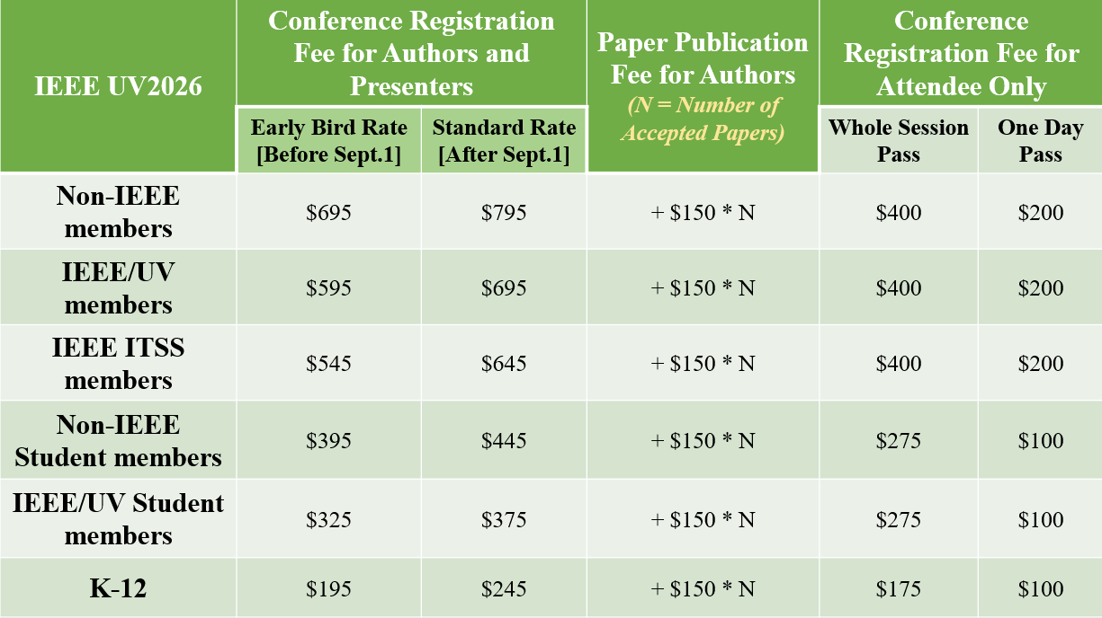
Registration Fee
*All fees are in USD and subject to confirmation on the official UV2026 registration page.
Notes:
Note the no show on the Session Report form
DO NOT move to the next paper. Attendees plan for the talks they want to hear based on the published schedule.
Choose one of these options:

Slide 37

Thank You!
Let’s Work Together to Make IEEE UV2026
Successful!
Another UV Milestone!

